Slide 1
AES_Project_2021_2022
Politecnico di Milano
Automation and Control Engineering
Group’s Members:
Borgnino Michele
Crespi Davide Marco
Riva Alessandro
Firetto Alessandro

Slide 2
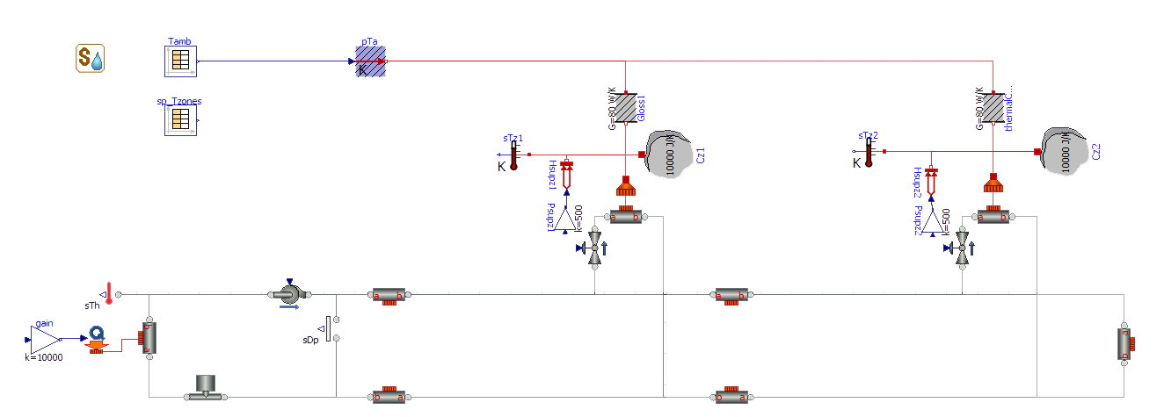
Uncontrolled system

Slide 3
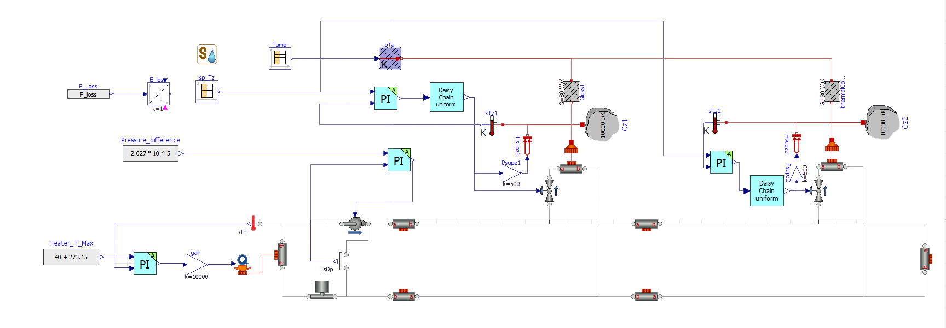
Controlled system

Slide 4
Heater model and tracking

Slide 5
Pump model

Slide 6
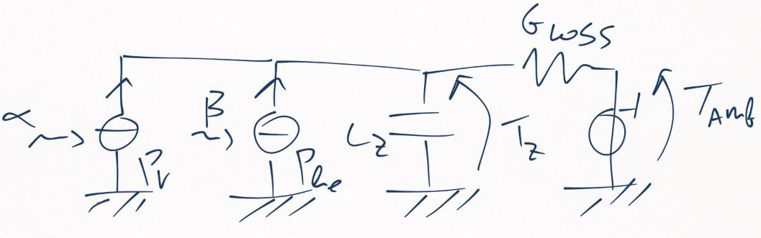
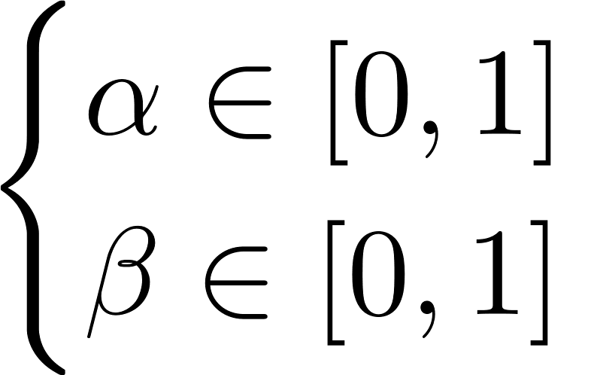
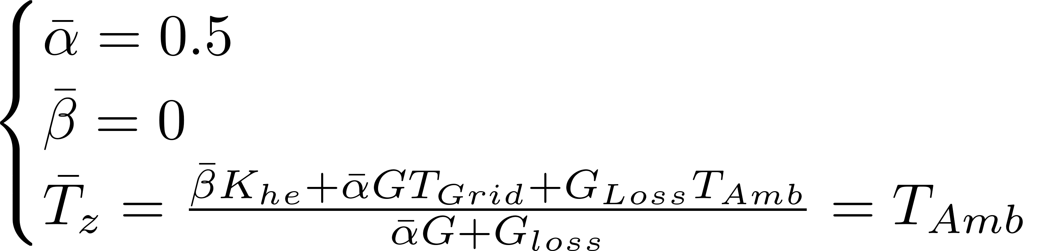
Zones model

Slide 7
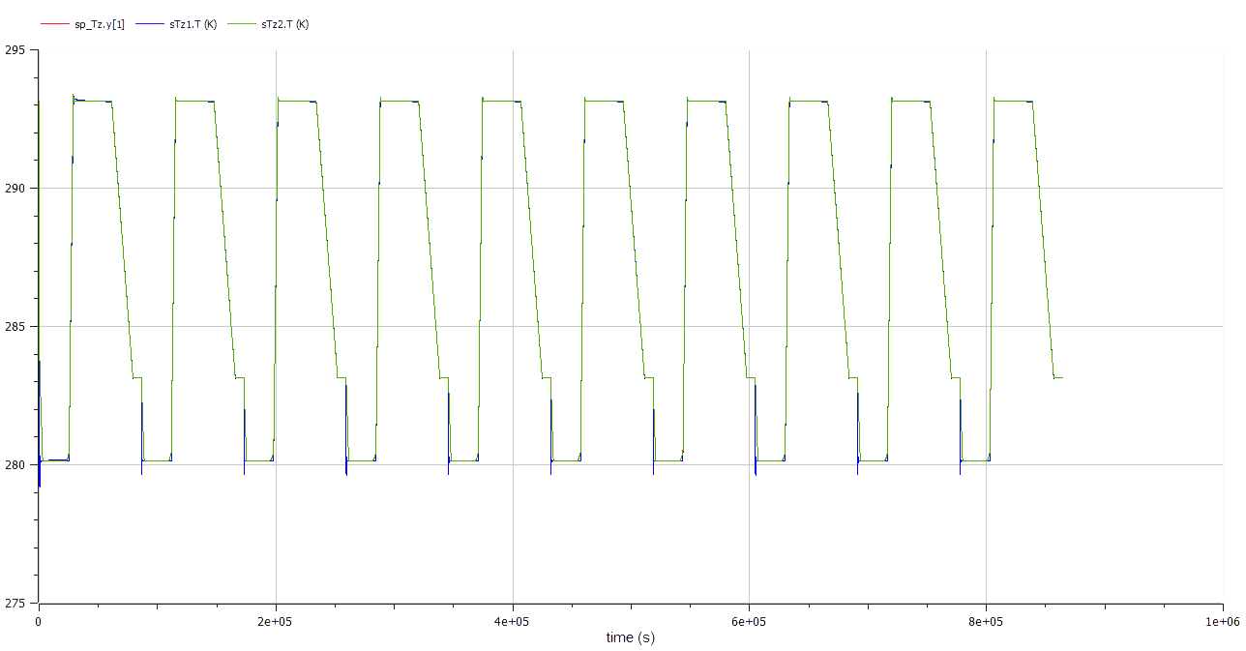

Zones set point tracking

Slide 8
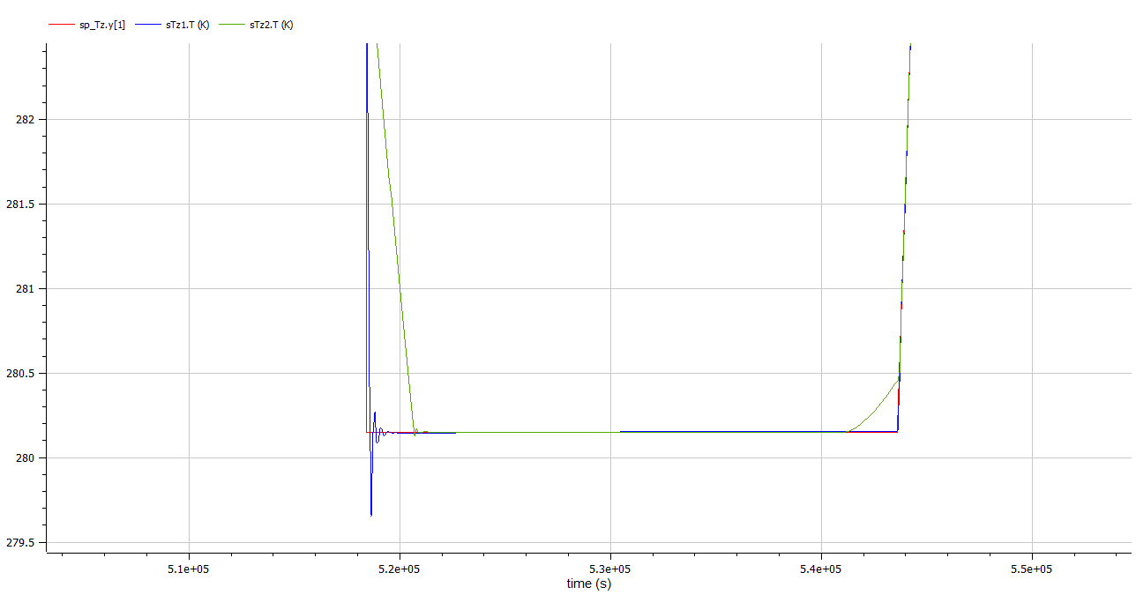


Slide 9
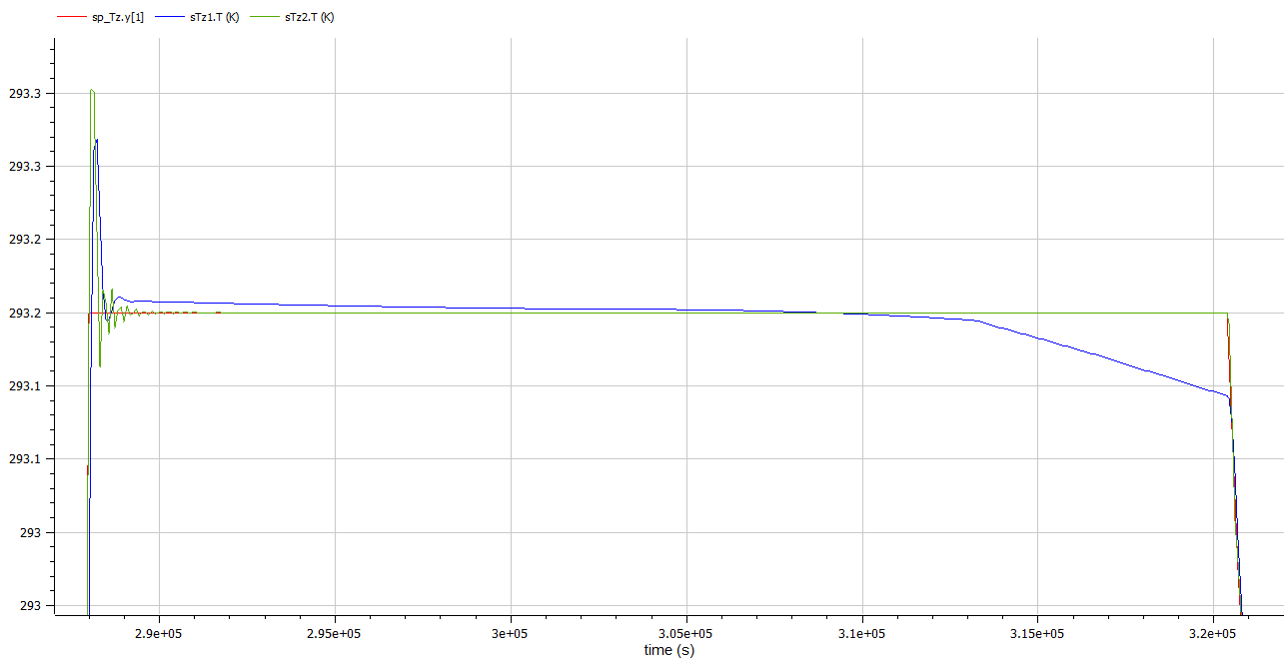





Slide 10
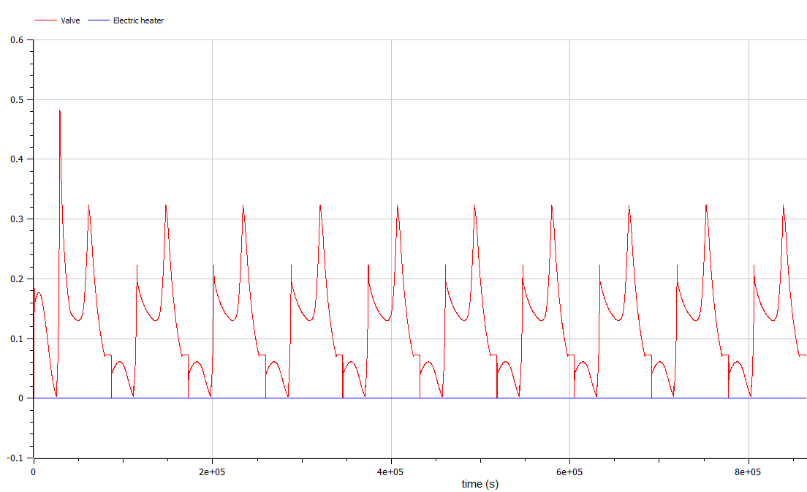
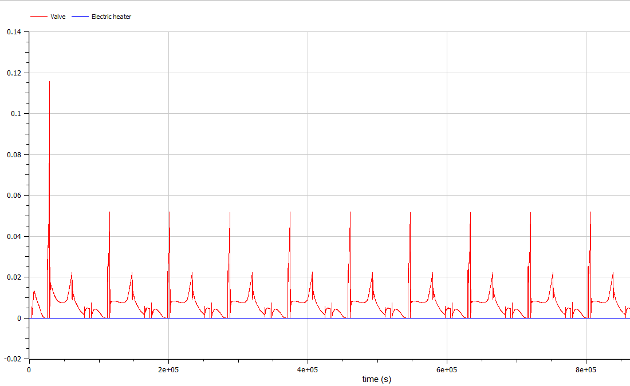
Control signals of each actuator

Slide 11
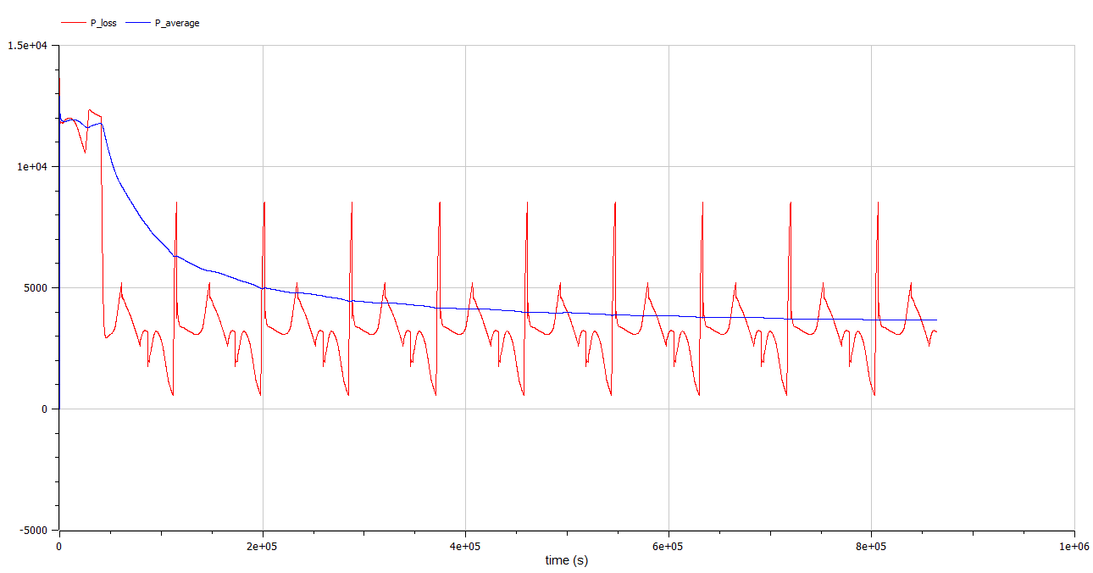
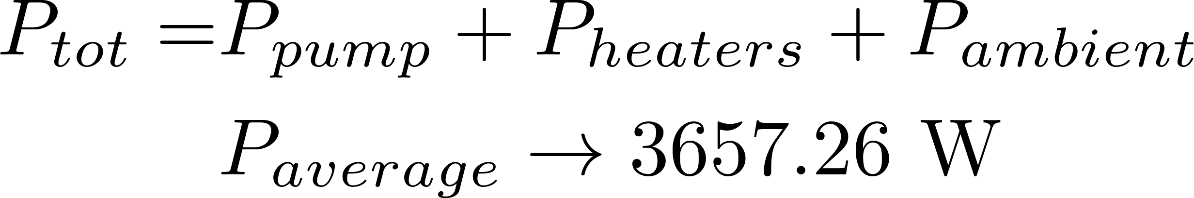
Power consumption

Slide 12
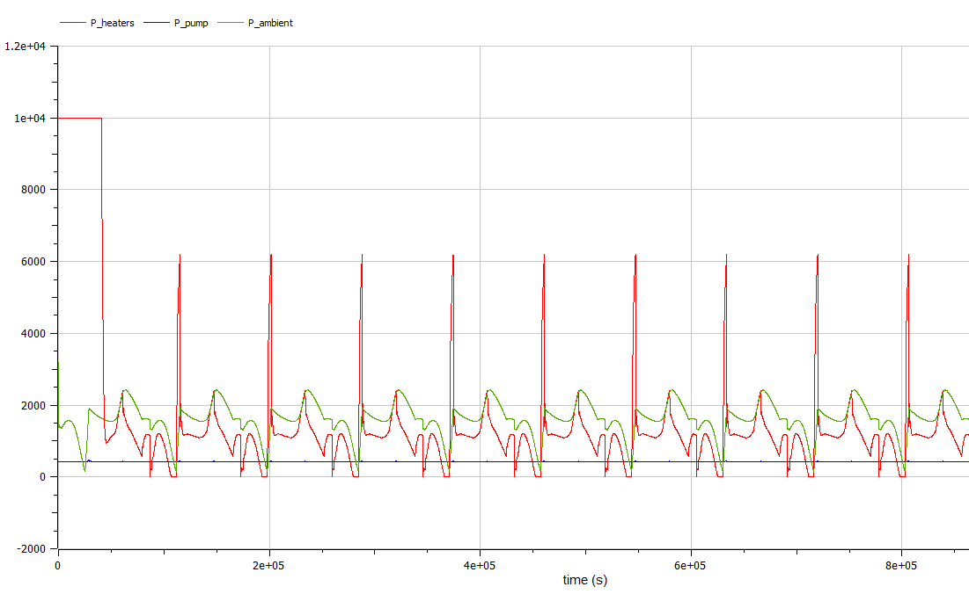
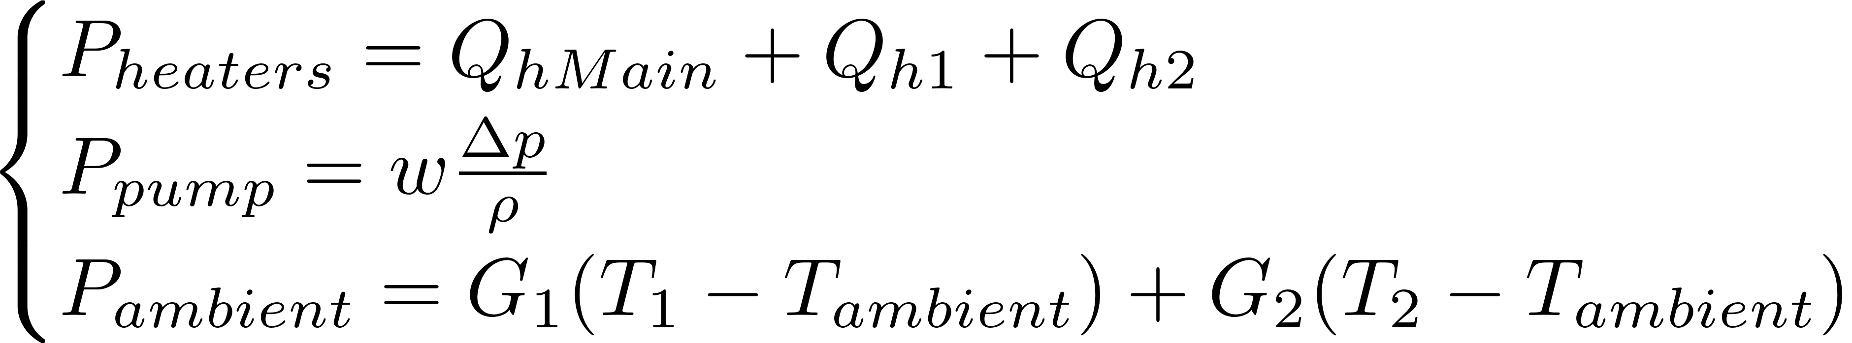
Individual power consumptions

Slide 13
